Slide 1
General Biochemistry
Dr. Saad hussein khudhair

Slide 2
What is Biochemistry?
Biochemistry is the chemistry of the living cell.
  It describes in molecular terms the structures, mechanisms, function and chemical processes shared by all living organisms.
  It provides fundamental understanding of the molecular basis for the function of living things.
  It provides a broad understanding of the molecular basis of life.
Examples:
  The chemical structures of biomolecules.
  Interactions leading to formation of supermacro-molecules , cells, multi- cellular tissues, and organisms.
  Bioenergetics of the reactions in the cell.
  Storage and transmission of information.
  Chemical changes during reproduction, aging, and death of cells.
  Regulation of chemical reactions inside living cells.

Slide 3
Principal Areas of Biochemistry
Structure-function relationship:
  Structural Chemistry for proteins, carbohydrates, DNA/RNA, lipids, and every other
component in the cell.
  Functions of these components
  Relationship between structure and function.
Metabolism:
  Catabolism: Pathways of chemical reactions leading to the breakdown of molecules
  Anabolism: pathways of chemical reactions leading to synthesis of molecules.
  Bioenergetics of reaction as well as management of cellular Energy.
Cellular communication
  Storage, transmission, and expression of genetic information
    DNA replication and protein synthesis.
  Cell-cell communication & interaction
  Signal transduction

Slide 4
Cell Theory
The main parts of the cell theory today are:
Cell is the smallest unit of living matter.
  Don’t confuse this with electrons, protons, atoms, proteins, DNA, etc. These are lifeless molecules
Cell is the structural & functional unit of all organs and/or
organisms.
All organisms are composed of one or more types of cells.
All cells come from pre-existing cells by division.
Cells contains hereditary information which is passed from cell to cell during cell division.
All energy flow (metabolism & biochemistry) of life occurs within cells.

Slide 5
Typical Cells
Cells from different organisms have different shapes, structures, and sizes.
All cells have protoplasm.
They are usually divided into two broad groups: Eukaryotes and Prokaryotes.
  Eukaryotic cells (Eu = true; kary = nucleus): have a membrane-bound nucleus and a variety of organelles and internal membranes.
  Prokaryotic cells (Pro = before) are smaller (a general rule) and lack much of the internal compartmentalization and complexity of eukaryotic cells; No membrane-bound nucleus or other organelles.

Slide 6
Characteristics of Living Organisms
There are 6 main Characteristics:
1- The highly organized Cells 2- Relation with energy
3- Grow and Reproduce with high fidelity 4- Interact with environment
Movement
Homeostasis

Slide 7

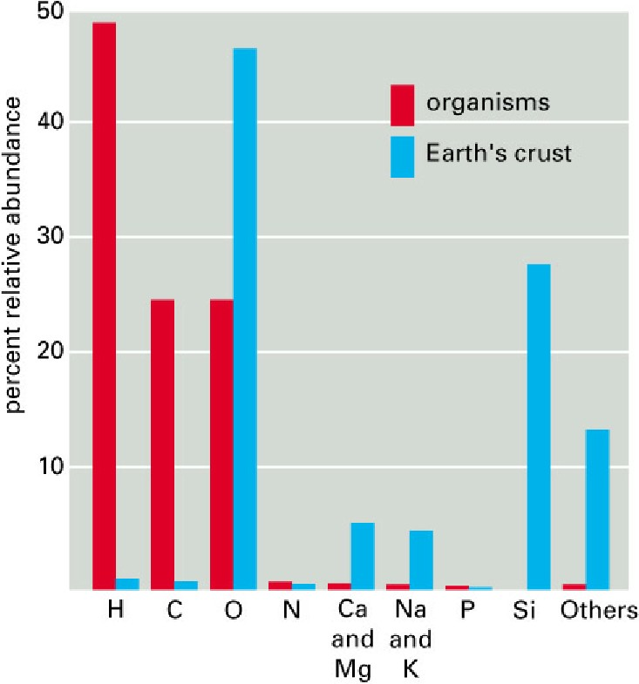
Chemical elements of cell
Chemical elements of a living cell are the same as in the Earth’s crust, but in diferent proportions.

Slide 8
Chemical Elements of Life
C H N O P S: are the most abundant elements in cell.
  They account for more than 99% of atoms in the human body
H, O, N and C have common properties that are important to the chemistry of life.
  They all:
    have relatively low atomic numbers
    capable of forming one, two, three and four bonds (for H, O, N and C , in order).
    form the strongest covalent bonds in general.
Write the atomic number and the atomic mass of each element (CHNOPS)

Slide 9
Chemistry and Life
Living organisms operate within the same laws that apply to physics and chemistry:
Conservation of mass, energy
•Laws of thermodynamics
•Laws of chemical kinetics
•Principles of chemical reactions

Slide 10
Chemistry of biomolecules
There are 5 major forces that maintain the structure of biomolecules:
Only one is a strong force: The covalent bond
The others are considered weak forces:
  The ionic bond
  The hydrogen bond
  Hydrophobic interaction (not chemical bond)
  Van Der Waals attraction (not chemical bond)

Slide 11
The 4 Major macromolecules
There are 4 major macromolecules (polymers) in the cell formed by condensation of smaller building blocks (monomers) by the removal of H₂O (dehydration):
Macromolecule (polymers) | Building blocks (monomers) | Name of bond
Carbohydrate | Monosaccharides | Glycosidic bond
Proteins | Amino acids | Peptide bond
Nucleic acids | Nucleotides | Phospho diester bond
Lipids | Fatty acids + alcohol | Ester bond

Slide 12
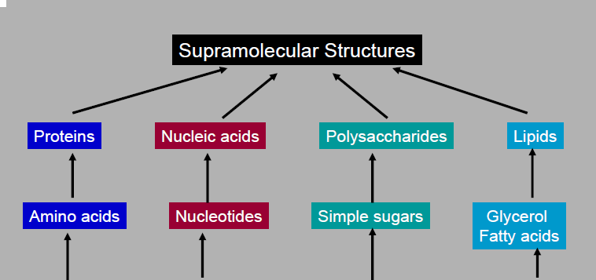
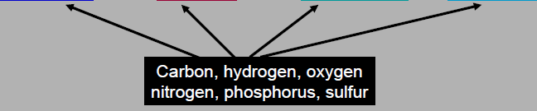
CHNOPS vs monomer vs macromolecules

Slide 13
Characteristics of biological molecules
All macromolecules have a “Sense” or Directionality
  DNA : -ATC- ≠ -CTA-
  Protein: -Gly-ser- ≠ -Ser-Gly-
  Carbohydrate: -Glu-Gal ≠ -Gal-Glu-
Macromolecules are Informational:
  Examples: Examples: AUC= Isoleucine; ACU= Threonine; UAC= Tyrosine
Macromolecules Have Characteristic Three- Dimensional Architecture
Weak forces maintain biological structure and determine biomolecular interactions

Slide 14

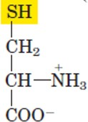
Functional Groups in Biochemistry
Examples from biochemistry
R OH OH
Alcohol Hydroxyl
Example: amino acid (serine)
R SH
Thiol
SH
Example: amino acid (cysteine)
Sulfahydryl
O
R C O
O
R C OH
Carboxylic acid
O C
Example: fatty acid
(Palmitic acid)
-
OH
CH₃(CH₂)₁₆COOH
Carboxylate

Slide 15
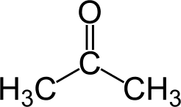
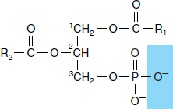

Functional Groups in Biochemistry
Examples from biochemistry
O
R C R
O C
Carbonyl
O
C R
Acyl
Example: acetone
Ketone
O
O P O
O
-
-
P O
-
Example: Phosphatetic acid
O
OH
Phosphate
Phosphoryl
O
R C NH₂
Amide
O
R C H
Example: acetamide
Aldehyde

Slide 16
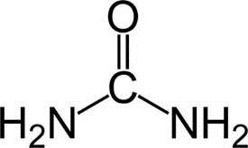
Functional Groups in Biochemistry (Cont.)
Examples from biochemistry
R₁
N H
R₁
+
R NH₂
Primary
R N R₂
Tertiary
NH₃
R
Secondary Amines
NH₂
Amino
Example:
Urea

